Slide 1
Fasciola hepatica
Common Names: The sheep liver fluke; the common liver fluke.
DR SOWMYA R.S.G
DEPT OF PATHOLOGY AND MICROBIOLOGY
SKHMC

Slide 2
Geographical Distribution. Cosmopolitan.
Habitat. A parasite of herbivorous animals (sheep, goat and cattle), living in the biliary passages of the liver. It is occasionally found in man.

Slide 3
Morphology.
Adult Worm. It is a large leaf-shaped fluke, measuring 3 cm in length by 1.5 cm in breadth and brown to pale grey in colour.
There are two suckers, the oral sucker is smaller. The anterior end bearing the oral sucker forms a conical projection.

Slide 4
The posterior end is rounded. The acetabulum is situated in a line with the two shoulders formed by the broadening of the conical projection posteriorly.
Life span of the adult worm in sheep is 5 years and in man 9 to 13 years.

Slide 5
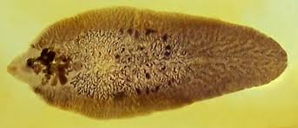

Slide 6
EGGS.
(i) Large, operculated, ovoid in shape, brownish yellow in colour (bile-stained).
(ii) Size 140 pm by 80 um.
(iii) Contains a large unsegmented ovum in a mass of yolk cells.
(iv) Excreted with the bile into the duodenum and then passed out along with the faeces.

Slide 7
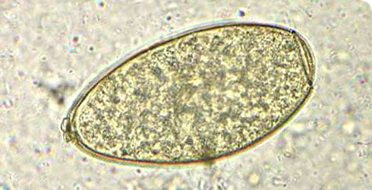

Slide 8
Life Cycle
F. hepatica passes its life cycle in two different hosts
Definitive Hosts. Sheep, goat, cattle or man. Adult worm in the biliary passages of the liver. Reservoir host is primarily the sheep.
Intermediate Host. Snails of the genus Lymnaea. Larval development proceeds in this snail.

Slide 9
In water
The eggs passed out in the faeces of definitive hosts, mature in water; inside each egg, a ciliated miracidium is developed in the course of 2 to 3 weeks’ time.
On escaping from the egg, the miracidium finds its way to its suitably intermediate host.

Slide 10
Inside the lymph spaces of the molluscan host, the miracidium passes through the stages of sporocyst, two generations of rediae and finally to the stage of cercariae;
the whole cycle takes a period of 30 to 60 days.

Slide 11
Entering man
The mature cercariae escape from the snail into the water and encyst (metacercariae) in blades of grass or water-cress.
The encysted cercariae are swallowed along with the grass or water-cress by herbivorous animals (their final hosts) and occasionally by man.

Slide 12


Slide 13


Slide 14
In man
On entering the digestive tract, the metacercariae excyst in the duodenum, migrate through the intestinal wall into the peritoneal cavity, penetrate the capsule of the liver, traverse its parenchyma and ultimately settle in the biliary passages (taking about a month to migrate) and grow to sexual maturity.

Slide 15
The eggs are liberated in the faeces through the bile in about 3 to 4 months after infection. The cycle is then repeated.

Slide 16
Pathogenicity and Clinical Features
biliary colic with vomiting,
persistent diarrhoea, jaundice,
ascites and a tender hepatomegaly with peripheral eosinophilia (40-85%).
It is most common in sheep and cattle-raising countries.
During migration through peritoneal cavity, the larvae may lodge in ectopic locations and may form abscess there.

Slide 17
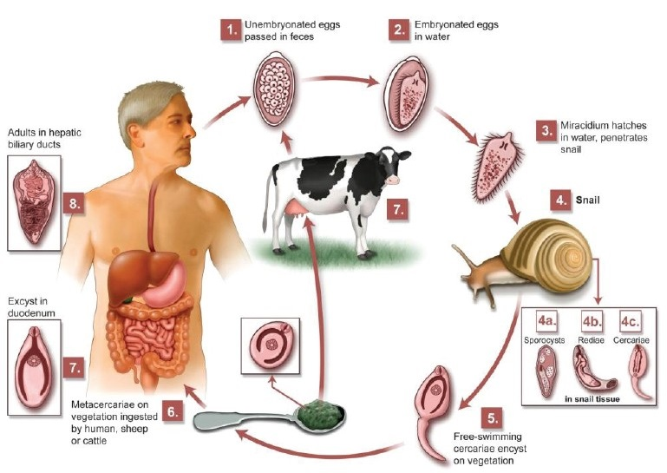

Slide 18
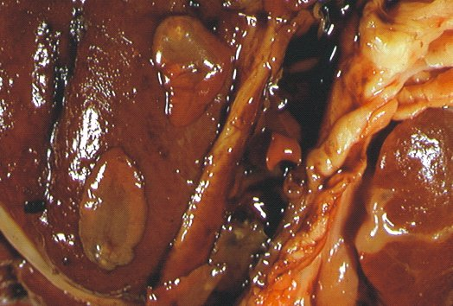

Slide 19
Liver rot disease in animals
F. hepatica is primarily responsible for producing a disease in the animals, known as “liver rot”.
During migration of the young worms (metacercariae or adolescariae) and their localisation in the biliary passages,

Slide 20
they cause extensive damage to the liver tissue and in heavy infections, may lead to portal cirrhosis.
While in the biliary passages, they may interfere with normal flow of bile, causing obstructive jaundice.

Slide 21
Diagnosis
This is based on the finding of eggs in stool or in bile obtained by duodenal intubation
High to moderate eosinophilia and elevated liver function test

Slide 22
Serological tests such as C.F.T.,
haemoagglutanation tests,
immunofluorescence assay,
immunodiffusion,
immunoelectrophoresis and
CCIE (sensitive test) may be helpful in diagnosis of the disease

